Slide 1
Error Detection and Correction
Types of Errors
Detection
Correction

Slide 2

Note
Data can be corrupted
during transmission.
Some applications require that
errors be detected and corrected.
10.<number>

Slide 3
Basic concepts
Networks must be able to transfer data from one device to another with complete accuracy.
Data can be corrupted during transmission.
For reliable communication, errors must be detected and corrected.
Error detection and correction are implemented either at the data link layer or the transport layer of the OSI model.

Slide 4
Errors
When an electromagnetic signal flows from one point to another, it is subject to unpredictable interference form heat, magnetism and other forms of electricity
This interference can change the shape and timing of the signal
If the signal is carrying encoded binary data, such changes can alter the meaning of the data.
10.<number>

Slide 5
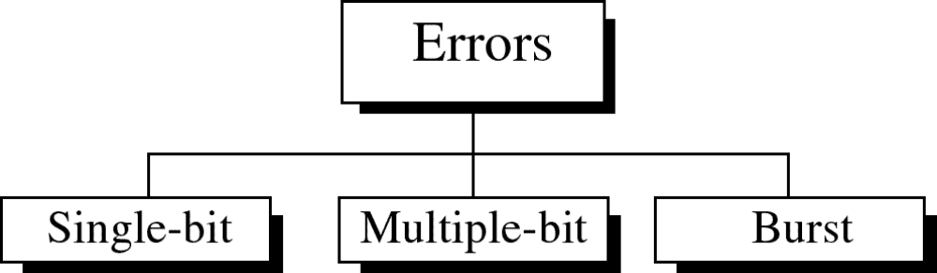
Types of Errors

Slide 6
Note
In a single-bit error, only 1 bit in the data unit has changed.
10.<number>

Slide 7
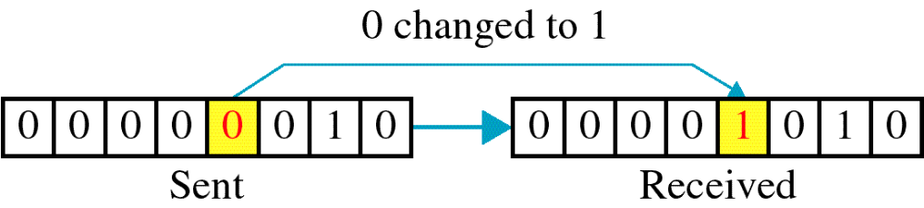
Single-bit error

Slide 8
Single bit errors are the least likely type of errors in serial
data transmission because the noise must have a very short
duration which is very rare.
However this kind of errors can happen in parallel
transmission.
Example:
If data is sent at 1Mbps then each bit lasts only 1/1,000,000 sec. or 1 μs.
For a single-bit error to occur, the noise must have a duration of only 1 μs, which is very rare.

Slide 9
Note
A burst error means that 2 or more bits in the data unit have changed.
10.<number>

Slide 10
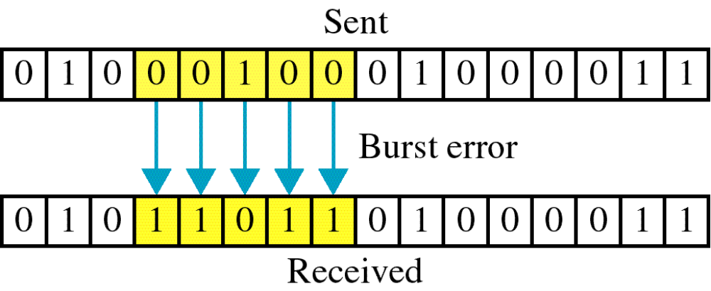
Burst error

Slide 11
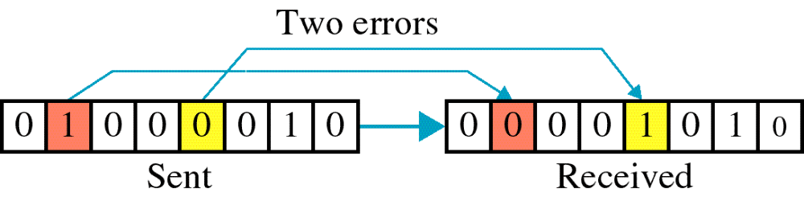

Slide 12
The term burst error means that two or more bits in the data unit have changed from 1 to 0 or from 0 to 1.
Burst errors does not necessarily mean that the errors occur in consecutive bits, the length of the burst is measured from the first corrupted bit to the last corrupted bit.
Some bits in between may not have been corrupted.

Slide 13
Burst error is most likely to happen in serial transmission since the duration of noise is normally longer than the duration of a bit.
The number of bits affected depends on the data rate and duration of noise.
Example:
If data is sent at rate = 1Kbps then a noise of 1/100 sec can affect 10 bits.(1/100*1000)
If same data is sent at rate = 1Mbps then a noise of 1/100 sec can affect 10,000 bits.(1/100*10⁶)

Slide 14
Error detection
Error detection means to decide whether the received data is correct or not without having a copy of the original message.
Error detection uses the concept of redundancy, which means adding extra bits for detecting errors at the destination.
Notes:
Make sense of message.
Make sense of message.

Slide 15
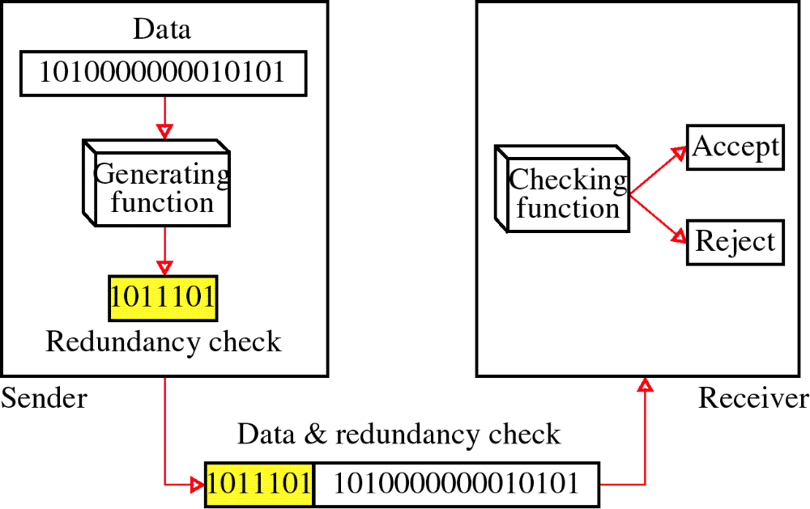
Redundancy

Slide 16
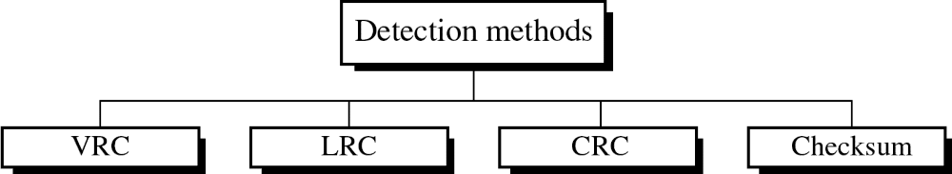
Four types of redundancy checks are used
in data communications
The first three VRC, LRC and CRC are normally implemented in the physical layer for use in the Data link layer. The fourth , checksum, is used primarily by upper layers.

Slide 17
VRC
Most common and least expensive mechanism for error detection is vertical redundancy check (VRC), often called a Parity Check
In this, a redundant bit called Parity bit is appended to every data unit so that the total number of 1s in the unit (including the parity bit) becomes even.

Slide 18
Suppose we have to transmit 1100001.
Adding together the no of 1s gives us 3, an odd number.
Before transmitting we pass the data unit through a parity generator
The parity generator count the no. of 1s and appends the parity bit (a 1 in this case) to the end.
The total no. of 1s in now 4, an even number
The system now transmits the entire expanded unit across the network link
When it reaches its destination, the receiver puts all eight bits through an even parity checking function.

Slide 19
If the receiver sees 11100001, it counts four 1s, an even number and the data unit passes
If instead of 11100001, the receiver sees 11100101 ? Then. When the parity checker counts the 1s, it gets 5, an odd number
The receiver knows that an error has been introduced into the data somewhere and therefore rejects the whole unit.

Slide 20
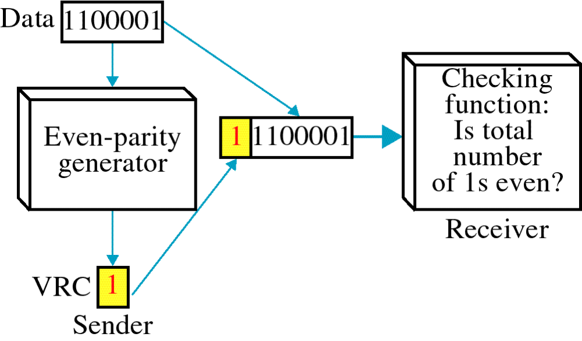
Vertical Redundancy Check
VRC

Slide 21
Performance
It can detect single bit error
It can detect burst errors only if the total number of errors is odd.(1,3,5 etc)

Slide 22
LRC
In Longitudinal redundancy check, a block of bits is organized in a table (rows and columns) and a redundant row of bits is added to the whole block
For example, instead of sending a block of 32 bits, we organize them in a table made of four rows and eight columns
We then calculate the parity bit for each column and create a new row of 8 bits, which are the parity bits for the whole block

Slide 23
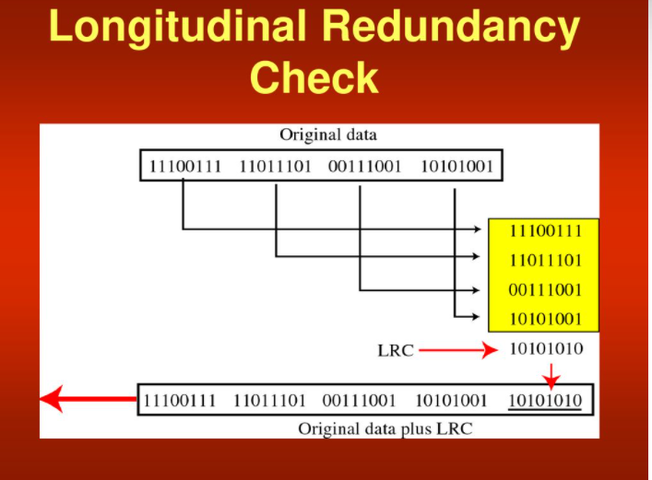

Slide 24
The first parity bit in the fifth row is calculated based on all first bits
The second parity bit is calculated based on all second bits and so on
We than attach the eight parity bits to the original data and send them to the receiver

Slide 25
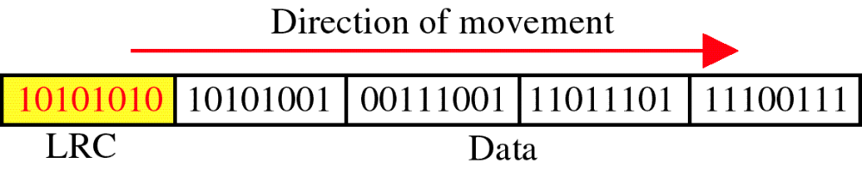
Longitudinal Redundancy Check
LRC

Slide 26
Performance
LCR increases the likelihood of detecting burst errors.
If two bits in one data units are damaged and two bits in exactly the same positions in another data unit are also damaged, the LRC checker will not detect an error.

Slide 27
Cyclic Redundancy Check
Unlike VRC and LRC which are based on addition, CRC is based on binary division
In this a sequence of redundant bits, called the CRC or the CRC remainder is appended to the end of the data unit so that resulting data unit becomes exactly divisible by a second, predetermined binary number
At its destination incoming data unit is divided by the same number.
If at this step there is no remainder, the data unit is assumed to be intact and is therefore accepted

Slide 28
A remainder indicates that the data unit has been damaged in transit and therefore must be rejected.
To be valid, a CRC must have 2 qualities :
It must have exactly one less bit than the divisor, and
appending it to the end of the data string must make the resulting bit sequence exactly divisible by the divisor

Slide 29
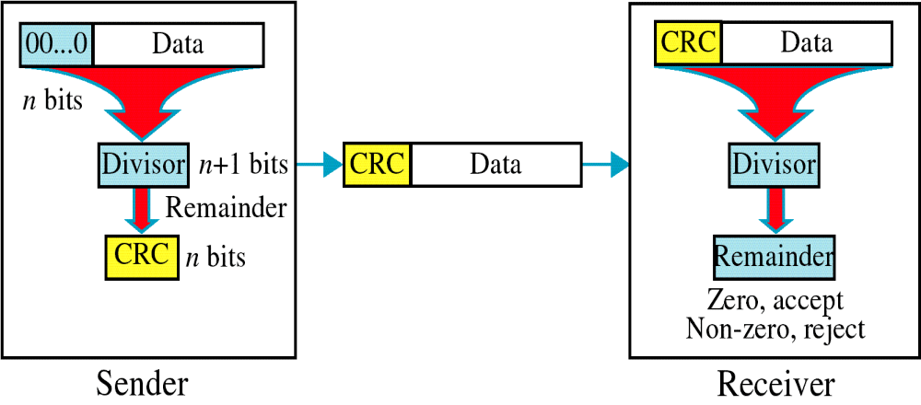
Cyclic Redundancy Check
CRC
First, a string of n 0’s is appended to the data unit. The number n is one less than the number of bits in the predetermined divisor, which is n+1 bits
Second, the newly elongated data unit is divided using a process called binary division. The remainder resulting from this division is the CRC
Third, the CRC of n bits derived in step 2 replaces the appended 0’s at the end of the data unit.

Slide 30
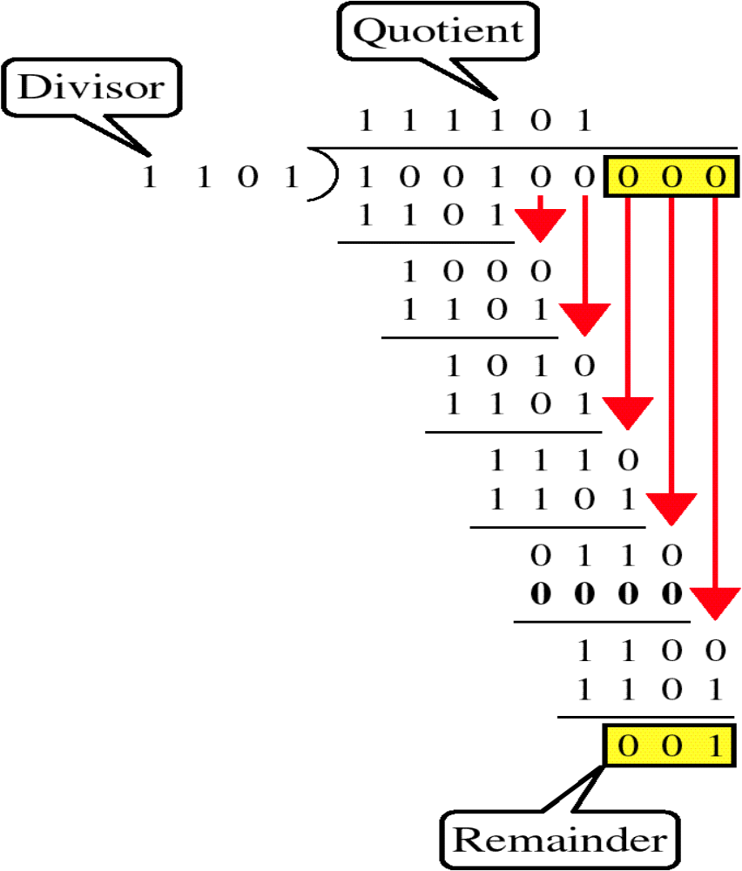
Binary Division

Slide 31
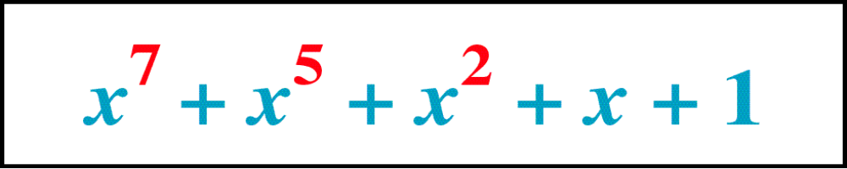
Polynomial
The CRC generator(divisor) is most often represented not as a string of 1s and 0s but as an algebraic polynomial.
This format is useful for 2 reasons :
It is short, and it can be used to prove the concept mathematically

Slide 32
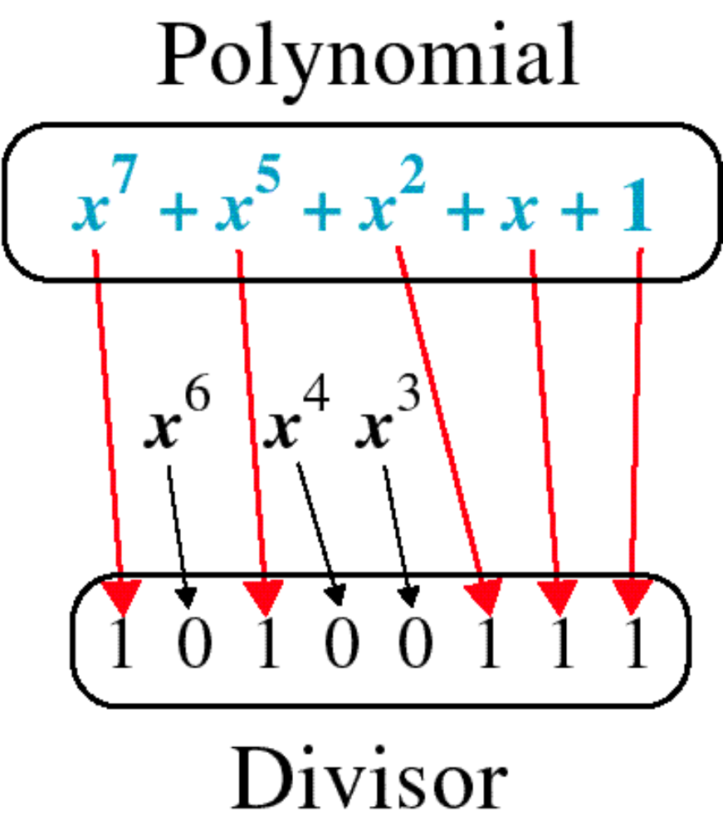
Polynomial and Divisor
Relationship of a polynomial to its corresponding binary representation

Slide 33
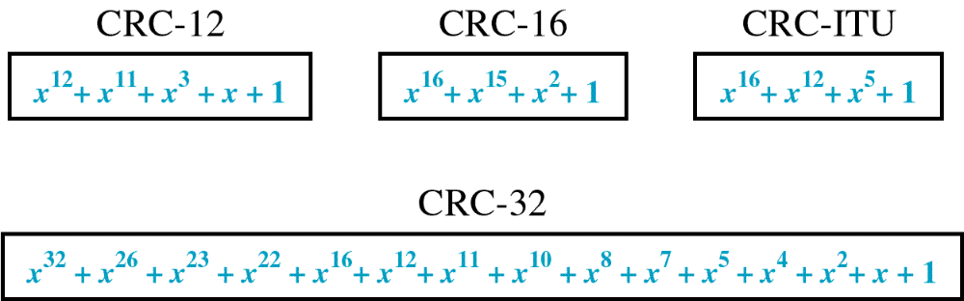
Standard Polynomials

Slide 34
Performance
CRC is very effective error detection method.
If the divisor is chosen according to the previously mentioned rules,
CRC can detect all burst errors that affect an odd number of bits
CRC can detect all burst errors of length less than or equal to the degree of the polynomial
CRC can detect with a very high probability burst errors of length greater than the degree of the polynomial

Slide 35
Checksum
The error detection mechanism used by the higher layer protocols is called a checksum
Like VRC, LRC, and CRC, Checksum is based on the concept of redundancy.

Slide 36
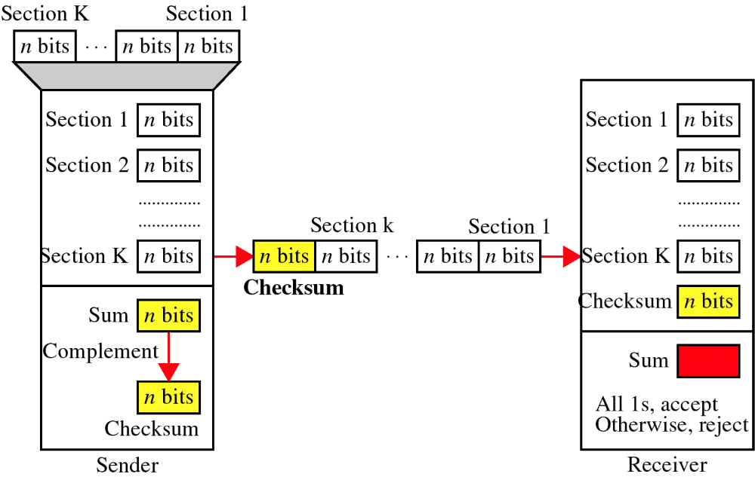
Checksum

Slide 37
At the sender
The unit is divided into k sections, each of n bits.
All sections are added together using one’s complement to get the sum.
The sum is complemented and becomes the checksum.
The checksum is sent with the data

Slide 38
At the receiver
The unit is divided into k sections, each of n bits.
All sections are added together using one’s complement to get the sum.
The sum is complemented.
If the result is zero, the data are accepted: otherwise, they are rejected.

Slide 39
Suppose the following block of 16 bits is to be sent using a checksum of 8 bits
10101001 00111001

Slide 40
10101001
00111001
-----------------
Sum 11100010
Checksum 00011101
The pattern sent is
10101001 00111001 00011101

Slide 41
Now suppose the receiver receives the pattern and there is no error
10101001 00111001 00011101
When the receiver adds the three sections together, it will get all 1s which after complementing, is all 0s and shows that there is no error
10101001
00111001
00011101
---------------------------
Sum 11111111
Complement 00000000 (means that the pattern is
OK)

Slide 42
Performance
The checksum detects all errors involving an odd number of bits.
It detects most errors involving an even number of bits.
If one or more bits of a segment are damaged and the corresponding bit or bits of opposite value in a second segment are also damaged, the sums of those columns will not change and the receiver will not detect a problem.

Slide 43
Error Correction
It can be handled in two ways:
receiver can have the sender retransmit the entire data unit.
The receiver can use an error-correcting code, which automatically corrects certain errors.

Slide 44
Single-bit error correction
To correct an error, the receiver reverses the value of the altered bit.
To do so, it must know which bit is in error.

Slide 45
Redundancy bits
To calculate the number of redundancy bits ( r ) required to correct a given number of data bits (m), we must find a relationship between m and r.
Number of redundancy bits needed
Let data bits = m
Redundancy bits = r
∴Total message sent = m+r
The value of r must satisfy the following relation:
2^{r} ≥ m+r+1

Slide 46
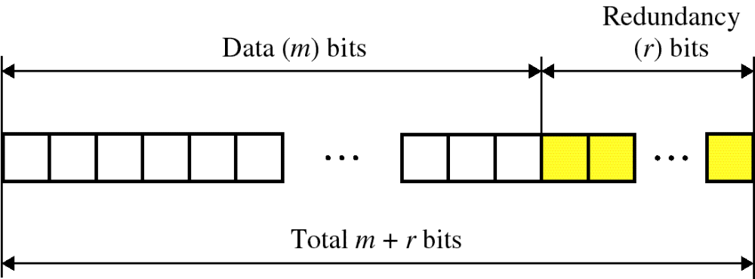
Error Correction

Slide 47
Relationship between data and redundancy bits
Number of Data bits (m) | Number of Redundancy bits ( r ) | Total bits (m+r)
1 | 2 | 3
2 | 3 | 5
3 | 3 | 6
4 | 3 | 7
5 | 4 | 9
6 | 4 | 10
7 | 4 | 11

Slide 48
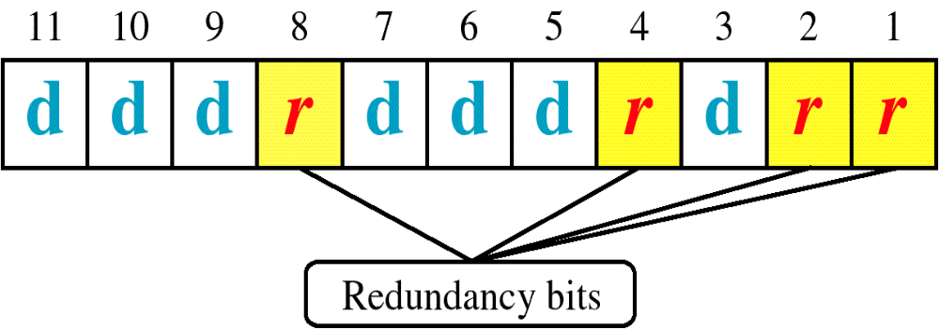
Hamming Code
It can be applied to data units of any length and uses the relationship between data and redundancy bits
Positions of redundancy bits in Hamming code

Slide 49
In Hamming code, each r bit is the VRC bit for one combination of data bits.
r1 is the VRC bit for one combination of data bits
r2 is the VRC bit for another combination of data bits and so on
The combination used to calculate each of the four r values for a 7-bit data sequence is as follows :
r1 : bits 1,3,5,7,9,11
r2 : bits 2,3,6,7,10,11
r4 : bits 4,5,6,7
r8 : bits 8,9,10,11

Slide 50
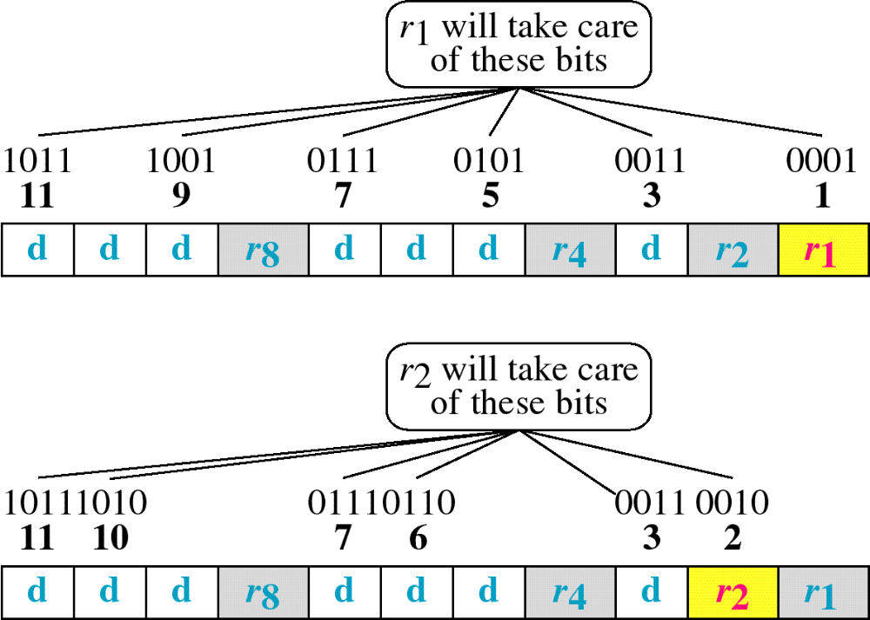
Hamming Code

Slide 51
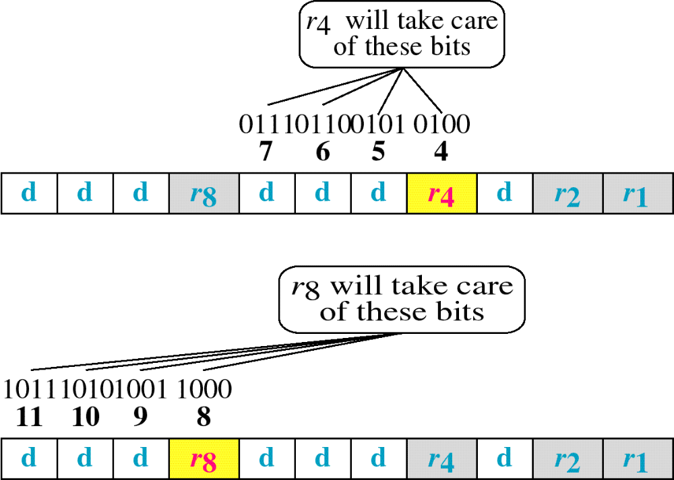
Hamming Code

Slide 52
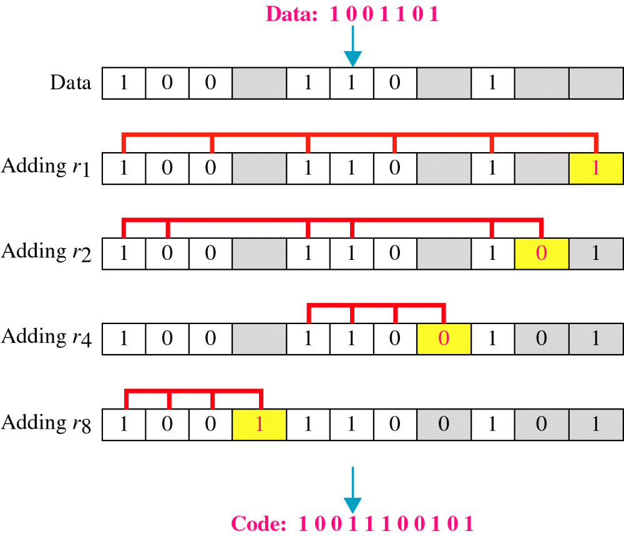
Example of Hamming Code

Slide 53
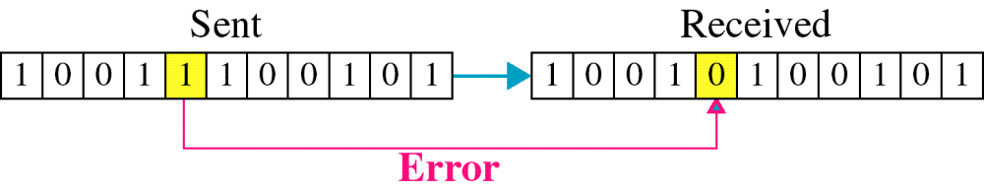
Single-bit error

Slide 54

Error
Detection

